Slide 1
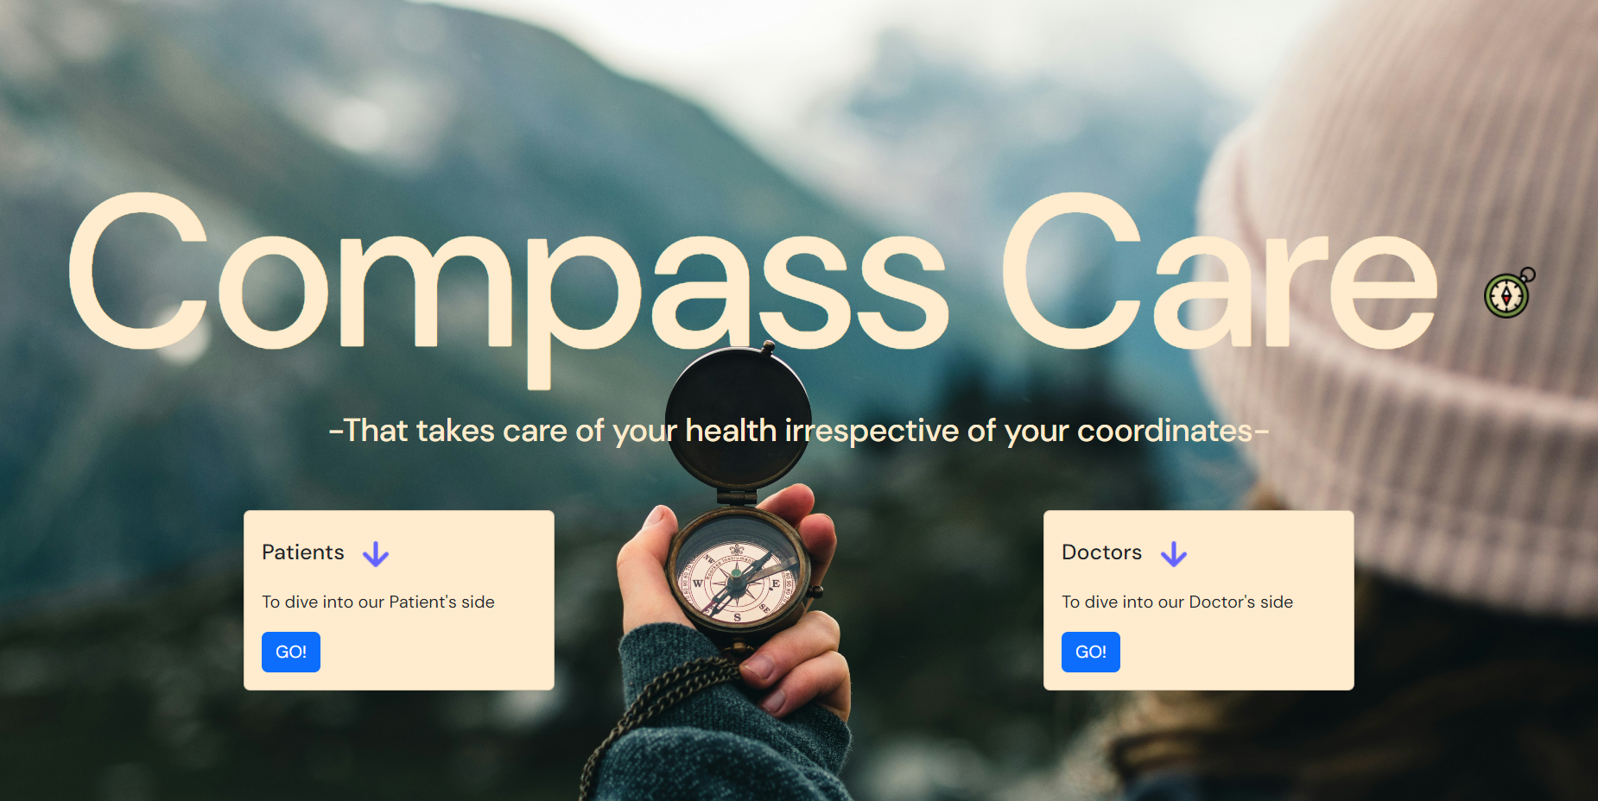

Slide 2

Problem Statement
Telehealth Innovation for Improved Patient Care
Description: Develop a cutting-edge telehealth solution that revolutionizes healthcare-service delivery, prioritizes patient-doctor communication, remote monitoring, and real-time data analysis. The goal is to enhance the overall efficiency, improve outcomes and advance telemedicine. The solution should be scalable, user-friendly, and compatible with existing healthcare systems.

Slide 3
Our Approach
We decided to make a centralized website for both patients and doctors.
Patients will be able to contact their doctors as and when required.
They will also be able to keep track of any necessary vaccinations for themselves and their children.
They also have the leeway to upload their prescriptions online for the doctors to view them and prescribe necessary further medications.

Slide 4
Our Approach
For the doctors, we have planned to give them access to real time analysis of their patient’s vitals.
They will also have the freedom to contact ambulances and pharmacies depending on the current status of their patient’s vitals.

Slide 5
Our Approach
We ultimately plan to merge both of these features together into a single website where both patients and doctors can work.
Patients can update their data as and when required, which will be visible to the doctors. Also, not just any doctor can gain access to the patient records, only the doctors who have been authorized by the patient can have access to that particular patient’s records.

Slide 6
The Team
Sriharsha Vadavalli (22BCI0199)
Sayar Chakraborty (22BCE3936)
Rohit Kumar Birakayala (22BDS0442)

